Slide 1
TOOLS OF NODE JS
By Vaibhav Jain and Pratiksha Misal

Slide 2
BUILD TOOL
  GRUNT
  GULP
  NPM
  CAKE
  BOCCOLI

Slide 3
GRUNT vs GULP
Simple task based build tool | Stream based build tool
Grunt is slower then gulp | Gulp is a faster in general
Grunt have large set of plugin . | Gulp have fewer plugin, and less documentation
Grunt has over 4000 plugins | Gulp has more than 1200 plugins
Grunt is not generally more concise and readable Grunt has a healthy community around it, even on Windows Gruntfile | Gulp is generally more concise and readable less community Gulpfile

Slide 4
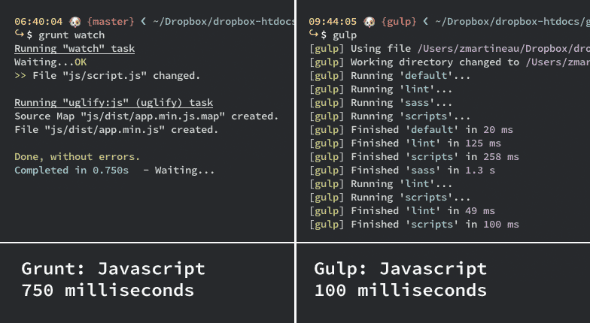
Speed comparison tests

Slide 5
Code quality tool
jslint | jshint
Less customizable | Very customizable.
 | JSHint is developed and supported by the JavaScript developer community and not by one very opinionated person.
 | JSHint works in the browser as well as in environments like Node.js and Rhino
jsLint shown maximum amount of errors by default. Eg.variable naming convention, regexp
It is very strict tool in syntax rules

Slide 6
Test Runner
KARMA
MOCHA
JASMINE
CASPERJS
SPECTACULAR
QUNIT
BUSTERJS

Slide 7
THANK YOU

